Slide 1
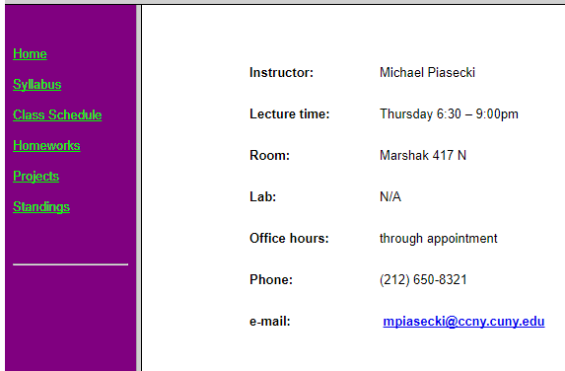
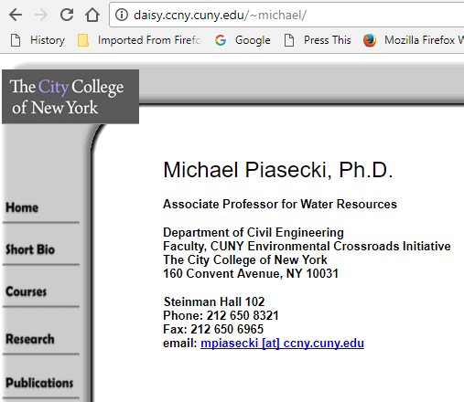
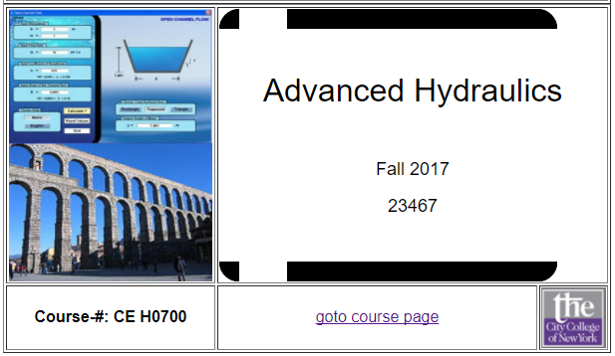
Course Website
http://michaelpiasecki.org
Thursday 6:00 – 8:30pm
CE Steinman 424
Fall 2024

Slide 2
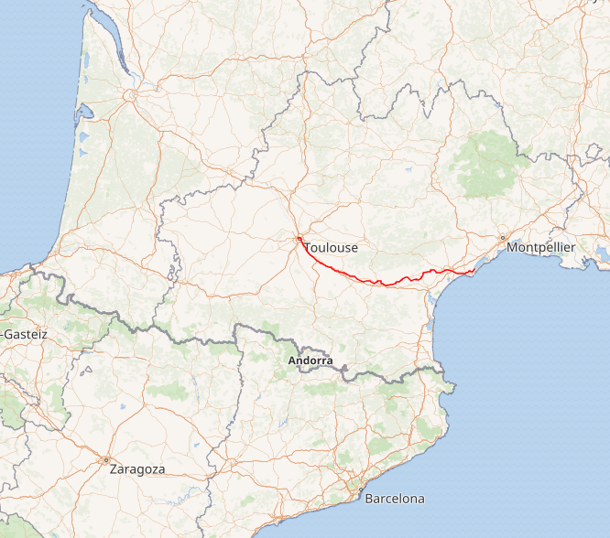
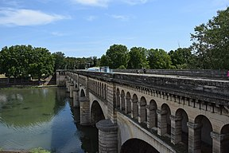
CE 0700 Advanced Hydraulics
Term Paper Fall 2024
Motivation:
Instead of having a mid-term, you will work on a term paper/report on a topic that is related to hydraulics. The paper should not be longer than 12 pages, with 1inch margins all around, and a font 11 Sans serif, for example Arial, or Calibri. The 12 pages include a title page and 1 page (max) for references. Everything else needs to fit into the remaining 10 pages. This term’s topic: The CANAL DU MIDI

Slide 3
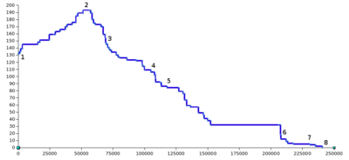
CE 0700 Advanced Hydraulics
Term Paper Fall 2024
Motivation:
The canal, situated in southern France, connects the city of Toulouse with the Mediterranean sea. Planning started in the early 1660s and construction began in 1667. The hydraulics are difficult because the first ~50km are actually uphill before going downhill at various slopes.
I expect you to address: - societal context; historical context
- Economics context;
- Construction challenges - hydraulic challenges (what type of flows, water volumes)
- Where is the canal today

Slide 4
CE 0700 Advanced Hydraulics
Project Topics Fall 2020
Motivation:
Advanced Hydraulics will deal a lot with Open Channel Flow, i.e. free surface flows as they develop in
creeks, streams, rivers … this flow however is intricately linked to
Rainfall -> Runoff relationships (runoff ends up in Rivers)
GW flow River Flow interactions (baseflow in rivers is GW flow entering the stream bed)
Hence, it makes sense to provide a “REAL” context when conducting research or executing river
software/models. The learning effect is much larger when analyzing challenging set ups rather than
trying to solve abstract problems.
You will select some watersheds (small enough not to be overwhelming in terms of data needs)
and address some real problems, such as effects of increasing impervious areas, long-term vs short-
term simulations, and even see if we can predict what happens to streams when trying to address climate change. You can pick any WS, ~100km^ or a little larger, either in US or elsewhere.

Slide 5
CE 0700 Advanced Hydraulics
Project Topics Fall 2020
Basically:
Develop numerical models for watershed and streamflow simulations to
evaluate how water moves through watersheds and streamflow networks using common software packages.

Slide 6
CE 0700 Advanced Hydraulics
Project Topics Fall 2020
Questions:
How did hydrology change from being forested (200yrs ago) to being greatly denuded, or use LandUse changes i.e. what is it today as compared to 20yrs ago?
How does reforestation change the situation? How much does one need for it to show a marked positive impact?
Given climate change scenarios what will change from today until 2100? A) if nothing is done b) if one continues reforestation/restoration at the current pace
How do extreme events influence the river morphology? As compared to “normal” condition?
Will one model work better than another?

Slide 7
CE 0700 Advanced Hydraulics
Project Topics Fall 2020
Tools:
Hydrology
HEC-HMS Response Units
HEC GSSHA 2D gridded
SWAT Response Units
Hydraulics
HEC-RAS
GIS
ArcGIS
Q GIS
WMS (from AQUAVEO)
ArcSWAT SWAT plugin for ArcGIS
Q SWAT SWAT plugin for Q SWAT
HEC GeoRAS ArcGIS plugin for HEC-RAS (there is a QGIS plugin also)
HEC GeoHMS ArcGIS plugin for HEC-HMS
WMS provides interfaces to HEC-RAS
HEC-HMS
HEC GSSHA

Slide 8
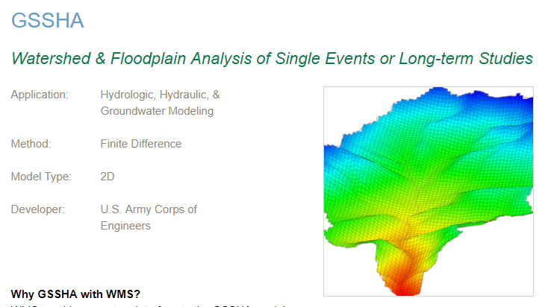
CE 0700 Advanced Hydraulics
Project Topics Fall 2020
Tools: Hydrologic Modeling
Using WMS from AQUAVEO

Slide 9
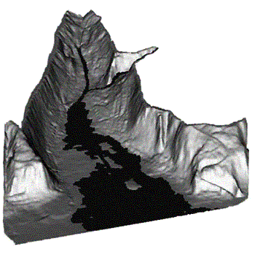
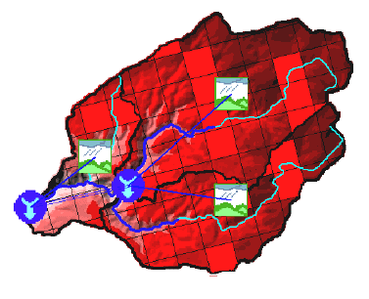
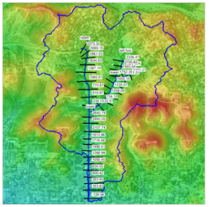
CE 0700 Advanced Hydraulics
Project Topics Fall 2020
Tools:
HEC-GeoHMS via ArcGIS
HEC-GeoRAS via ArcGIS
HEC-GeoRAS via WMS

Slide 10
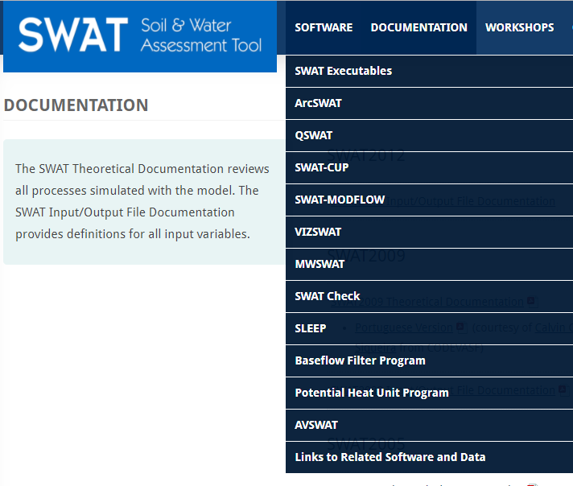
CE 0700 Advanced Hydraulics
Project Topics Fall 2017
Tools:
SWAT comes with ArcSWAT for use with ArcGIS) and
QSWAT for use with Quantum
GIS.
QGIS runs on a MAC! ArcGIS
does not!

Slide 11
CE 0700 Advanced Hydraulics
Project Topics Fall 2020
For Questions 1-3:
Use SWAT and address 3 scenarios: past, today, future, impact of reforestation
via ARCSWAT and/or via QSWAT
For questions 4-5
Use HEC-HMS and HEC-RAS to address now, and one extreme event (SANDY? ANDREW?
via ArcGIS or QGIS plugin
Use HEC-GSSHA to compete with HEC-HMS & HEC RAS
via WMS or QGIS

Slide 12
CE 0700 Advanced Hydraulics
Project Topics Fall 2020
Data:
All programs need Elevation Data. We have
NHD+ V2
NHD+ High Resolution
1m DEMs
All programs need LC/LU Data. We have
National Landcover Data Set 2016
https://www.mrlc.gov/
Land Cover
Land Use
All programs need Soil Data. We have
Statsgo (medium detailed)
SSURGO (detailed)
Also need NRCS Hydrologic Soil groups to compute curve runoff numbers (for SWAT)

Slide 13
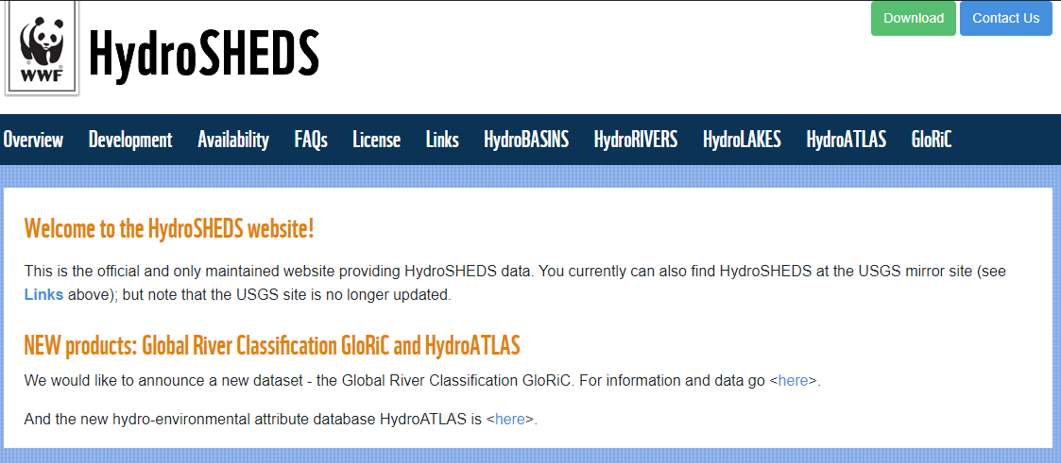
CE 0700 Advanced Hydraulics
Project Topics Fall 2020
Data: Check out HydroSheds https://www.hydrosheds.org/

Slide 14
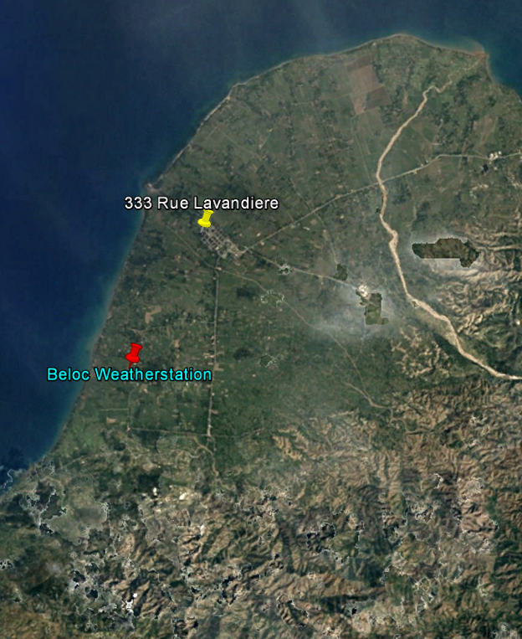
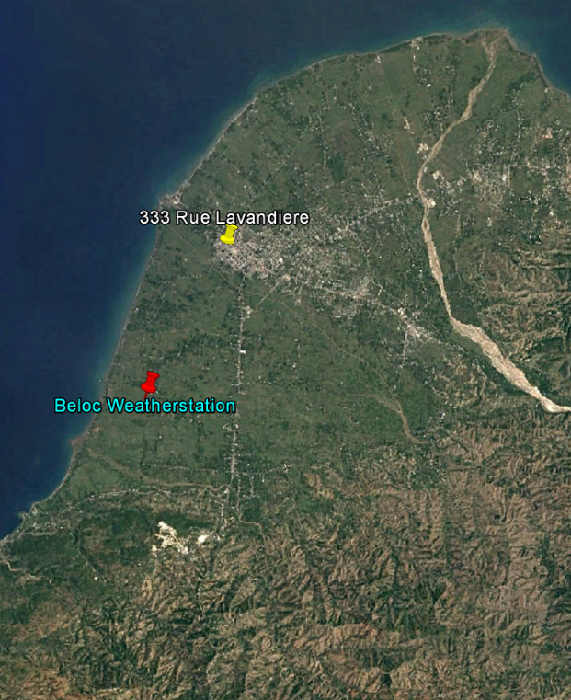
CE 0700 Advanced Hydraulics
Project Topics Fall 2020
Data:
Recommend to use Google Earth Pro for visual reference.
Satellite imagery from
DEC 1984 to AUG 2017
3 for 2017 alone!
Google made hi-res imagery available after 2010 Earthquake
1984
2017

Slide 15
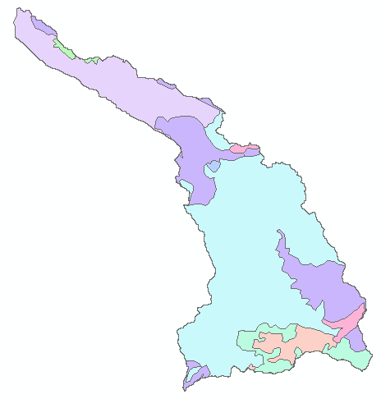
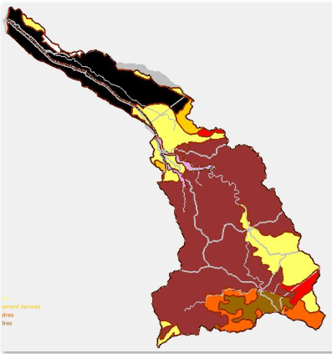
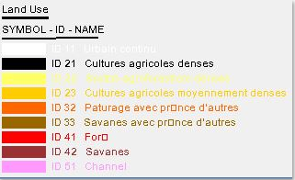
CE 0700 Advanced Hydraulics
Project Topics Fall 2020
Data:

Slide 16
CE 0700 Advanced Hydraulics
Project Topics Fall 2020
Data:
We have quite a bit, however some challenges arrive
- CC type data needs to be downscaled for forcing
Some data needs to be compiled first before it is ready for model ingestion this concerns spatial and temporal distribution
Some GIS layers do not exist for the use of Geo versions of programs => need create them. Pitfalls: projections are off

Slide 17
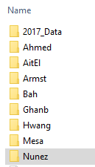
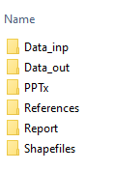
CE 0700 Advanced Hydraulics
Project Topics Fall 2020
I will put the data
I have In here
Every student gets a Dropbox folder (I will invite everyone individually)
Data will be made available on dedicated Dropbox folder
Data generated and results need to go into your Dropbox folder
Please organize your folder
Dropbox \CE_H0700

Slide 18
CE 0700 Advanced Hydraulics
Project Topics Fall 2020
I will need from you:
Preferred email address so I can invite to Dropbox
Next week a preferred choice, we will discuss and assign
Make sure you inspect your compute resources
A few words of Wisdom:
This is NOT a group project; you can give pointers perhaps or share where you got basic from but realize that you are in a competitive environment, what you share as part of your effort will enhance a classmate’s project => thus lower your own
Especially for the SWAT modeling: do you your own installation, set up, input file generation etc, If I see obvious copies credit will be severely reduced
Start NOW! Get yourself settled by installing and testing and running a couple of tutorials and read up on documentation.

